Slide 1
Key Considerations for a Successful Implementation of a Large Scale Financial System
Rudolph Daniels / MBA Scripting

Slide 2
How does a Methodology integrate into Application Design?
Assess
The implementation approach is an overlay to the Solution Integrator Transform methodology and one that seeks to apply an element of the Agile Approach against an otherwise waterfall PM methodology. The Design phase and Construct phase can be blended. This provides agility to support a more detailed and interactive design but still preserves the important rigour of formal stage gates between phases that is required to support good management of project scope, time-lines and economics.
Application Design
Design
Construct
As-is State Definition
Prototyping
Implement
High Level To-Be Definition
Design Documentation
Operate & Review
The PM
Blueprint
Refinements to Construct Phase Assumptions and Plans
Using the implementation approach during Design gives the client a perception that the Design phase is longer and the construct phase is shorter.
Design
Construct
© 2018 MBA Scripting. All Rights Reserved

Slide 3
Architecture & Design Outputs
Deliverable | Description / Purpose
Detail Functional Design Document | Written in a manner that allows business users and stakeholders to clearly understand and visualize the to-be processes and solution to be developed and contains robust references / screen shots taken directly from the proto-types to reinforce a clear understanding of how the technology will support the proposed solutions
Detail Technical Design Document | The Detailed Technical Design Document contains the design principles behind the Essbase and Hyperion Planning details and the Hyperion planning solution components such as applications, plan types, dimensionality matrix and application performance settings
Data Flow Architecture | The Data Flow shows how data is moved between applications ranging from ERP, EPM, BI and other reporting systems
Application Architecture | An applications architecture describes the behavior of applications used in a business, focused on how they interact with each other and with users. It is focused on the data consumed and produced by applications rather than their internal structure. In application matrix the applications are usually mapped to business functions and to an application. The applications architecture is specified on the basis of business and functional requirements. This involves defining the interaction between application packages, databases, and middleware systems in terms of functional coverage. This helps identify any integration problems or gaps in functional coverage
Oracle EPM Proto-type Application Components | Where-ever relevant to do so, the proto-type components defined in Oracle EPM can be preserved as starting points for the Construct phase. This can save time and money during the overall project
© 2018 MBA Scripting. All Rights Reserved

Slide 4
Creating Business Process & Technology Roadmap
Business Process Assessment
Technology Assessment
Application Utilization Matrix
Technology & IT Support Infrastructure
Business Process Constraints
Financial Reporting, Budgeting, Consolidation (IFRS / Multi-GAAP)
Flexibility to meet future growth
Data Cleanliness & Integrity
Fit & GAP Analysis
Organization Restructuring
Business Process & Technology Roadmap
Key Deliverables
Finance business process optimization opportunities
Organizational restructuring and alignment opportunities
Application optimization opportunities
Future state application architecture
Prioritized application implementation roadmap and plan
Project staffing and training plan
High-level business case and benefits realization framework
© 2018 MBA Scripting. All Rights Reserved

Slide 5
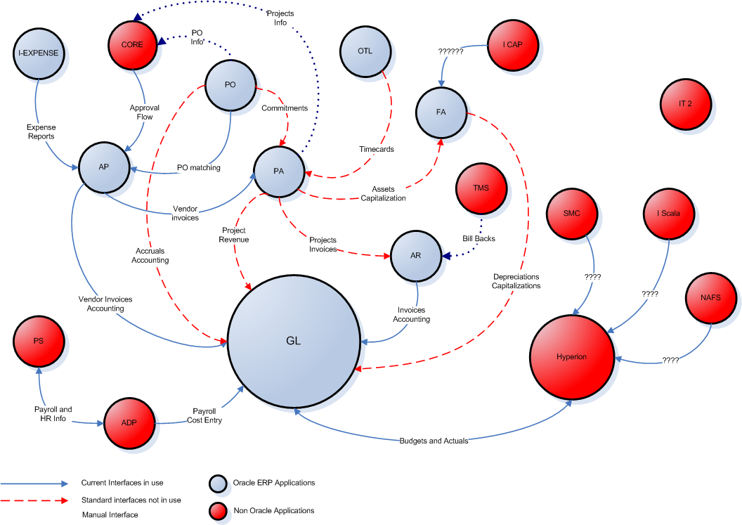
Current State of Corp Financial Systems
Manual Load
SHG
Actuals
Actuals
Actuals
Financial Systems Direction – Slide #5
Notes:
Nirnay

Slide 6
Common Factors for Establishing a Successful Implementation
Establishing a clear business case and action plan that addresses business challenges more specifically
Creating a business and technology roadmap focused on:
High priority initiatives
Management Reporting Analytics
Budgeting and Forecasting
Finance Process
Data Governance
ERP Chart of Accounts
Infrastructure Technology
Data Warehouse
© 2018 MBA Scripting. All Rights Reserved

Slide 7
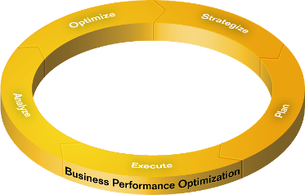
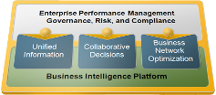
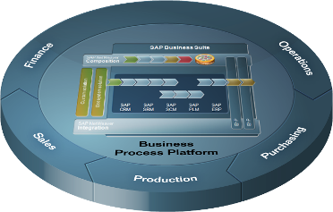
Strategic Vision
Business Performance Optimization
Executive Sponsor
Steering Committees
Corporate Strategy
Provides Leadership
Governs Project Risk
Executive Steering
Committee
Project Sponsors
Align Organizational Strategy
Engages Stakeholders
Project Management Team
Operational Steering Committee
Problem Solving
Advisory
Committee
Scope
Project Management Office
Define Project
Scope
In Scope
Establish Project Methodologies
Project Tracking
Out of Scope
Scope Change
Description
Scope Change
Log
Project Support
Project Roadmap
Execution

Slide 8
Strategic Questions Business Performance Optimization
Selection of
Solution Integrator
Evaluating Proposals & Vendors
Strategy
Prior Performance
Business Acumen
Previous Solutions
Implemented
Business Case
Development
Consultation
Demo w/Client Data
Client Documentation
PM Experience w/ Technology
References
Cloud vs On Premise
Project Manager
Long Term
Financial Cost
Sensitive Information
Client Ready
Deliverables
Product Knowledge
Assess Variance of Functionality
Hybrid Application Approach
License Cost
Development Experience
Business
Experience
Execution

Slide 9
Selection of Solution Integrator Meticulous Selection Process / Unasked Questions
Intelligence Gathering on a potential SI is the most important responsibility of the selection committee before the awarding the contract. All energies should be directed at obtaining as much intelligence as possible ranging from PMO effectiveness, delivery, development, testing, training, business acumen, professionalism, issues/challenges from previous referenced and unreferenced SI clients in order to make an informed decision on the chosen consulting firm
Intelligence
Gathering on SI
Prior Performance
Assessing the prior performance of a solution integrator gives the potential client insight into the technical capabilities, strengths/weakness, and challenges
Assess the client engagements of the developers and compare them to the advertising of the solution integrator in an attempt to understand who the client has not referenced
The ability to work with the business community in a professional manner to understand the quandaries they are trying to resolve. Embedding the development team with the business is essential to the success to the implementation
The evaluation of the technical and functional team business acumen is paramount to the success of the implementation
Business Acumen
Development Team
An evaluation of the development team is critical to the success of the implementation and the assessment of the developed teams experience by application is also paramount to the success of the implementation
Consultation
The consultation of the technology to client should be thoroughly vetted along with providing a business cases for additional technologies offered to resolve any quandaries, in addition, to a product demonstration of the technology
In addition, an Advisory group should be considered as a reliable check on the Solution Integrator
PM Experienced w/ the technology
The role of the Project Manager on any engagement is critical to the success of the implementation and integrating the various teams together (i.e. Business community, IT & SI).
Intricate knowledge of the product will be paramount in leading and integrating the client and the development team

Slide 10
Evaluating Proposals and Vendors Meticulous Selection Process / Unasked Questions
Intelligence Gathering on a potential SI is the most important responsibility of the selection committee before the awarding the contract. All energies should be directed at obtaining as much intelligence as possible ranging from PMO effectiveness, delivery, development, testing, training, business acumen, professionalism, issues/challenges from previous referenced and unreferenced SI clients in order to make an informed decision on the chosen consulting firm
Intelligence
Gathering on SI
Previous Solution Implemented
Assessment of previous solutions implemented and viability of the solution
Business Case Process
Development of business case processes and presentations as a result of suggesting new technologies from discovery sessions
Product Demonstration
Provide demonstration of the of recommended technologies with client metadata and data
Provide potential data flow architecture given information provided in the RFP
Client Documentation
Provide examples of functional and technical documentation from previous clients, therefore, you can examine quality of work and other solutions developed
References
Attempt to gather intelligence on clients not referenced via resumes submitted for the engagement

Slide 11
Cloud vs On-Premise Environment Meticulous Selection Process / Unasked Questions
Intelligence Gathering on a potential SI is the most important responsibility of the selection committee before the awarding the contract. All energies should be directed at obtaining as much intelligence as possible ranging from PMO effectiveness, delivery, development, testing, training, business acumen, professionalism, issues/challenges from previous referenced and unreferenced SI clients in order to make an informed decision on the chosen consulting firm
Financial
Impact
Perform financial analysis on purchasing on-premise hardware vs cloud servers
Assess additional hidden future cost for the next 3,5,7 & 10 years for on-premise vs cloud services
Assess licensing cost on purchasing on-premise vs cloud servers
Perform the necessary due diligence by reaching out to similar corporate or government entities on the pro & cons of each option financially
Long Term Financial Cost
Sensitivity of Information
Determine sensitivity of the financial data for on-premise vs cloud servers
Assess who has access to client financial data within Oracle Cloud Service Support and how secure is the data
Obtain recommendation from IT Security Team and inquire with other private and public entities
Assessment of Functionality
Assess the current and future variance of any functionality between on-premise vs cloud applications
Hybrid Application Approach
Assess if a Hybrid Approach will meet the clients infrastruture and application architecture requirements
Assess the long term viability of a Hybrid Application Approach
License Cost
Assess the cost differential in license cost between on-premise vs cloud applications

Slide 12
Project Manager Business Acumen / Technological Sound
Intelligence Gathering on a potential SI is the most important responsibility of the selection committee before the awarding the contract. All energies should be directed at obtaining as much intelligence as possible ranging from PMO effectiveness, delivery, development, testing, training, business acumen, professionalism, issues/challenges from previous referenced and unreferenced SI clients in order to make an informed decision on the chosen consulting firm
Ability to Lead the Client & Development Team
Assess capabilities of delivering client ready documents that have been well vetted, error free, before delivering to the business
Ability to review deliverables from the development team that resolve the business quandary, development work, presentations, business cases before delivery to the business
Client Ready Deliverables
Product Knowledge
In depth knowledge of the technology, therefore, you can advise the business and lead the development team successfully through the implementation
Business Experience
Seasoned professional who has the business acumen and the ability to intergrate the disparate teams into one organization
Development Experience
Seasonal professional who understands the technical nuausiannce of developmenting the applications, therefore, they can understands the tasks assoicated with the developers and can review their work product before delivery to client

Slide 13
Strategic Questions Business Performance Optimization
Integration of Solution Integrator w/Client
Functional / Technical Resource
Strategy
Leadership
Strategy / Roadmap
Finance/Accounting
Background
IT Background
Business Acumen
Consultation
Developer
Background
Solution Architect
Development
Knowledge of
P&L, BS & Capital
Selecting Client Team Members
Politics
Technical PM
Functional PM
Inefficiency
Missed Opportunities
Business Analyst
IT EPM Developers
Independent Advisory Council
Ill-advised Decisions
Unqualified Resources
Execution

Slide 14
Integration of Solution Integrator w/Client Leadership / Partnership
Intelligence Gathering on a potential SI is the most important responsibility of the selection committee before the awarding the contract. All energies should be directed at obtaining as much intelligence as possible ranging from PMO effectiveness, delivery, development, testing, training, business acumen, professionalism, issues/challenges from previous referenced and unreferenced SI clients in order to make an informed decision on the chosen consulting firm
Ability to Lead the Client & Development Team
Leadership
Assess the capabilities of the solution integrator PMO Teams previous experience in leading and advising large scale financial technology implementations
Strategy / Roadmap
Development of strategy/roadmap, business cases and presentations in conjunction with corporate implementation initiatives
Business Acumen
Ability to quickly understand the business and translate the information to the technology
Assess risk and opportunities to lead to the desired outcome
Consultation
The abiltiy to bring unique consultation skills together from a variety of engagements and advise the client on strategies and the direction of the engagement in an effort to minimize risk and expand upon opportunities
Development Team
The abilty to bring the development team and business community together and understand how to integrate the requirements into the applications and review the code that satisfies the requirements

Slide 15
Functional / Technical Resources Business Acumen / Technological Sound
Intelligence Gathering on a potential SI is the most important responsibility of the selection committee before the awarding the contract. All energies should be directed at obtaining as much intelligence as possible ranging from PMO effectiveness, delivery, development, testing, training, business acumen, professionalism, issues/challenges from previous referenced and unreferenced SI clients in order to make an informed decision on the chosen consulting firm
Ability to integrate with Client & Development Team
Finance / Accounting Background
Provides the value of quickly understanding the different line of businesses from previous experience working in a corporate finance or accounting group
IT Background
Overall IT background with a variety of different skills set ranging from quality assurance, servers, security, infrastructure and operating systems
Developer Background
Provides the value and brings the experience of being able to develop the technology in an efficient manner
Solution Architect
Provides the value of being able to bring Finance/Accounting, IT and Development background to the engagement to design the overall solution, supervise the developers and advise the client
The ability to work with disparate groups and bring all various entities together, answer detail questions and provide efficient solutions
Knowledge of P&L, Balance Sheet & Capital Projects
Complete understanding of the financial statement

Slide 16
Selecting Client Team Members Business Acumen
Intelligence Gathering on a potential SI is the most important responsibility of the selection committee before the awarding the contract. All energies should be directed at obtaining as much intelligence as possible ranging from PMO effectiveness, delivery, development, testing, training, business acumen, professionalism, issues/challenges from previous referenced and unreferenced SI clients in order to make an informed decision on the chosen consulting firm
Trusted relationship w/ the business community
Technical PM
Provides value by giving overall direction from a technical aspect and validating the solutions offered by the implementation team and reviewing technical documentation to ensure the documentation is client ready
Functional PM
Provides value by coalescing the business community, ensuring the business requirements are meet and provide overall direction for day-to-day activities for the entire project
Review the solutions offered by the solution integrator with business community with a prototype demonstration
Business Analyst
Provides significant value by being able to explain the detailed work of the various business entities
Provides noteworthy value by being able to write the requirements for the RFP and review the Solution Integrators requirements after the discovery session with the business entities
Provides substantial value by working with the implementation team, coordinating the gathering of metadata and data from disparate sources systems (i.e. HR, Accounting, Financial, Data Warehouse) for the implementation team
Integrates with the implementation development team for knowledge transfer sessions and continuation of future development
IT EPM Developers
Provides the unique knowledge and skills to review the overall solution/design provided and offer a validating or differing opinion to ensure the overall mission, goals and corporate strategy initiatives are being meet by the implementation
Independent Advisory Council

Slide 17
Politics The Unspoken Word
Intelligence Gathering on a potential SI is the most important responsibility of the selection committee before the awarding the contract. All energies should be directed at obtaining as much intelligence as possible ranging from PMO effectiveness, delivery, development, testing, training, business acumen, professionalism, issues/challenges from previous referenced and unreferenced SI clients in order to make an informed decision on the chosen consulting firm
Minimize
Inefficiencies
Minimize
Missed Opportunities
Minimize
Ill-Advised Decisions
Minimize
Unqualified Resources
Minimize
Result: Potential failed implementation, missed Go-Live and inadequate solution

Slide 18
Current & Former Clients
© 2018 MBA Scripting. All Rights Reserved
Notes:
Key Points
Best Practices/Implementation Considerations

Slide 19
Do you have any questions?
Rudolph Daniels / MBAScripting.com
© 2018 MBA Scripting. All Rights Reserved
Notes:
Key Points
Ask participants if there are any question

