Slide 1
Federal Update: GFOA Washington Metropolitan Area
Emily Swenson Brock
Director, Federal Liaison
11/7/2018

Slide 2
Federal Advocacy
Congressional Advocacy
    Tax exempt municipal bonds
    Deductibility of state & local taxes
    Marketplace Fairness Act
    Pensions & benefits
Executive Advocacy
    SEC
    MSRB
Amicus Briefs to the Supreme Court

Slide 3
Agenda
Happy day after Election Day?
Revenues
  SALT
  Economic nexus
Debt
  Advance Refunding
  New Disclosure Requirements

Slide 4
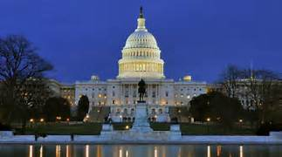
A New Day, A New Congress!

Slide 5
Tax Reform Results
 | HR1 | S1 | “THE TAX CUTS AND JOBS ACT” *
SALT | Prop Cap $10k | Prop Cap $10k | Prop, Income and Sales Cap $10k
Advanced Refunding | Eliminated | Eliminated | Eliminated
Private Activity Bonds | Eliminated | Preserved | Preserved
Tax Credit Bonds | Eliminated | Preserved | Eliminated
Stadium Bonds | Eliminated | Preserved | Preserved
MID | $500k | $1M | $750k
Corporate Rate | 20% | 20-ish% | 21%
Individual Rate | Lowered | Lowered | Lowered

Slide 6
Impacts of SALT Cap
State | District | Party Affiliation | % of Tax Returns Using SALT Deduction | Average SALT Deduction
DC | At-Large | D | 40% | $16,443
VA | 8 | D | 47% | $15,359
VA | 10 | R | 49% | $13,562
IL | 6 | R | 38% | $14,830
OH | 12 | R | 33% | $11,572
MN | 3 | R | 40% | $15,021
Gfoa.org/SALT

Slide 7
Wayfair v South Dakota
Estimated to be 15% of 2018 holiday sales

Slide 8
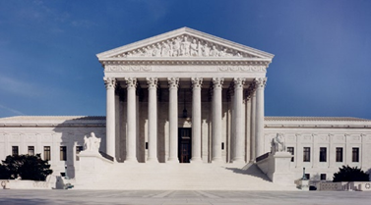
Bye Physical Presence, Hello Substantial Nexus

Slide 9
What We Know
Many states had previously passed legislation providing for remote collection.
  most began remote collection on October 1, 2018
  Many others delayed implementation of remote collection until January 1, 2019
Others are updating legislation to enable remote collection
Most (that we’ve heard about) are working to adhere to the simplifications and standardizations cited in the Wayfair opinion

Slide 10
Advance Refunding
Our Message:
  Reduced debt service costs
  freeing up resources to be used for other important purposes
  Minimizing taxpayer and ratepayer costs

Slide 11
What About the District?
Countless other projects held hostage
Asking for full reinstatement of tax-exempt advance refundings

Slide 12
New Disclosure Requirements
In August, the SEC approved new Amendments to Rule 15c2-12.
February 27, 2019 Governments will have to state in continuing disclosure agreements entered on or after the effective date that they will disclose to the market
  any new and material financial obligations
  notify the market when an outstanding or new financial obligation reflects material financial difficulties.
First Step: Talk with bond and/or disclosure counsel about how these changes specifically relate to your debt program and future bond issuance and other financial transactions.

Slide 13
GFOA Working With Industry Partners
What do you mean “financial obligations”?
  bank loans,
  capital leases,
  swaps,
  variable rate obligations, and
  other types of financial products that “operate as vehicles to borrow money.”
What do you mean “financial difficulties”?
  EMMA Improvements Planned
  WEBINAR: January 9th

Slide 14
GASB Updates
The GAAP Update rebroadcasts (December 5th and Jan 23rd)
GASB 88 – new debt disclosure requirements for all debt and new emphasis on private placements – effective for years beginning after June 15, 2018 (Current year for many).
GASB Preliminary Views documents on the reporting model and recognition concepts.
Watch for Implementation Guides:
  Fiduciary (Exposure Draft December 2018; Final May 2019; statement effective for years beginning after December 15, 2018)
  Leases (Exposure Draft February 2019; Final June 2019; statement effective for years beginning after December 15, 2019)

Slide 15

Los Angeles Conference
We offer scholarships for first time attendees – free registration

Slide 16

Future of the profession initiative

Slide 17
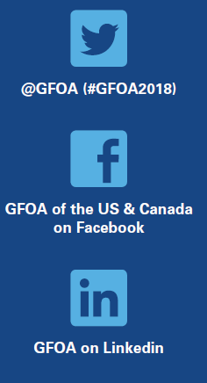
Thank You. For More Information…
Emily Brock
Director, Federal Liaison
202-393-8467
ebrock@gfoa.org
www.gfoa.org

